Slide 1

Server Roles
Team Pi

Slide 2
DHCP
Dynamic Host Configuration Protocol

Slide 3
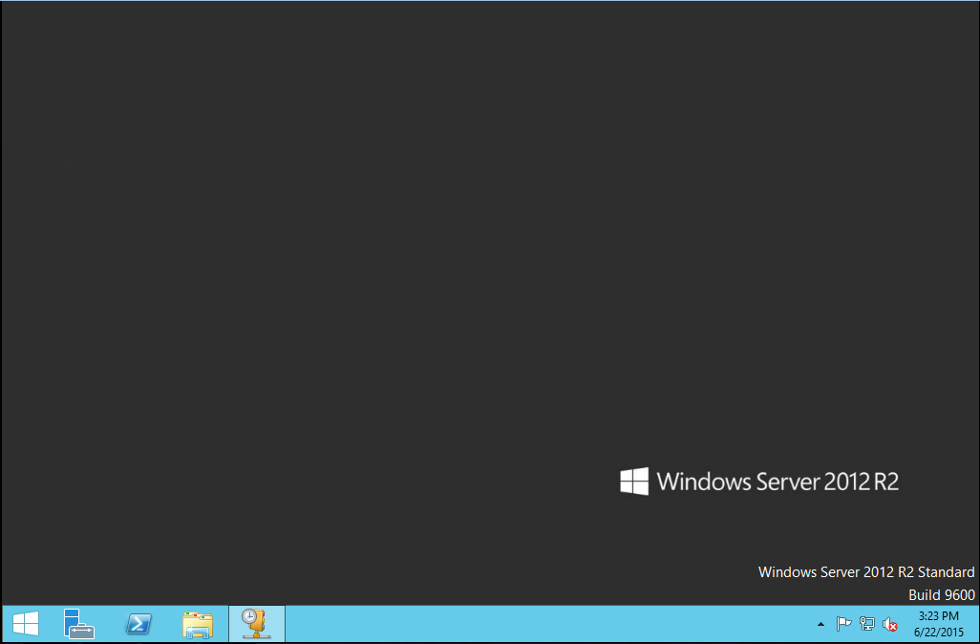
Install and configure DHCP and set the IP pool from 192.168.1.100 to 192.168.1.200
A DHCP server will be installed as a new server role on Windows Server 2012. To start open your Server Manager. By default it will be on your taskbar.

Slide 4
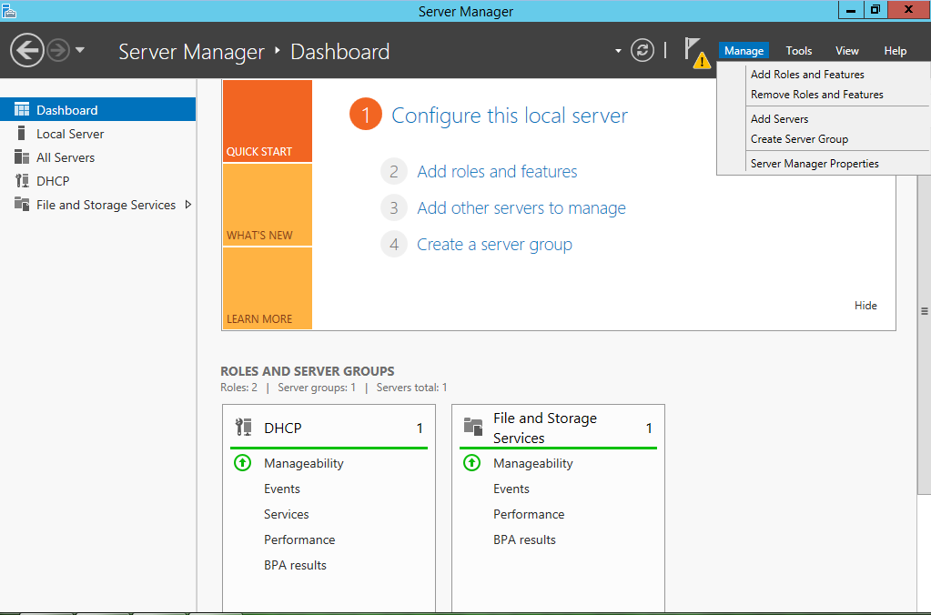
Install and configure DHCP and set the IP pool from 192.168.1.100 to 192.168.1.200
Now navigate to the Dashboard, and in the upper right corner click on manage. This will bring down a drop down menu. Select ‘Add Roles and Features’.

Slide 5
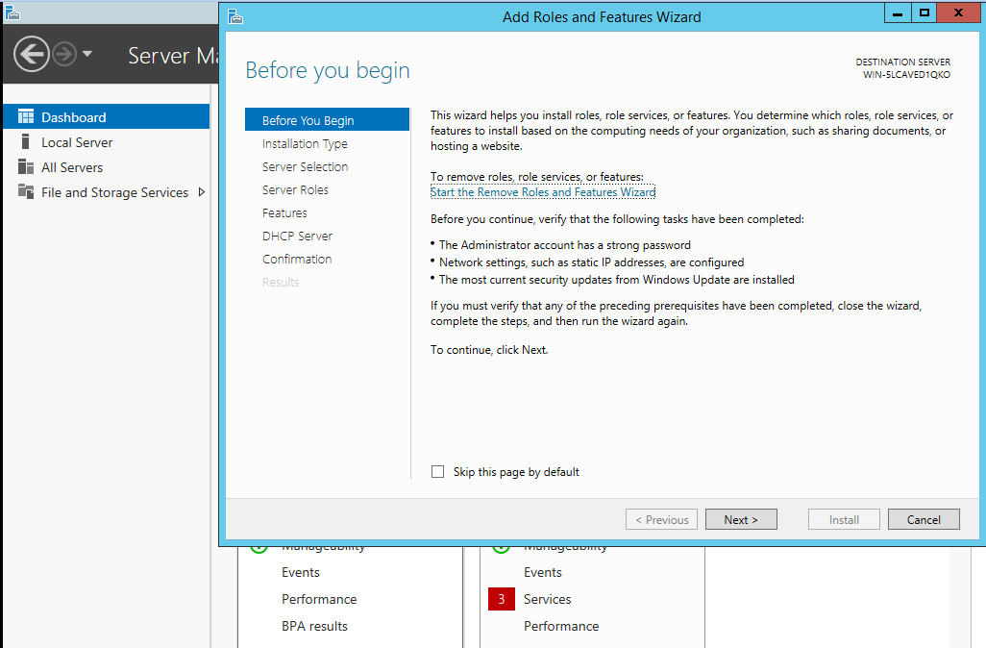
Install and configure DHCP and set the IP pool from 192.168.1.100 to 192.168.1.200
That will bring up the ‘Add Roles and Features Wizard’. This will guide you through the setup process. To start, click ‘Next >’

Slide 6
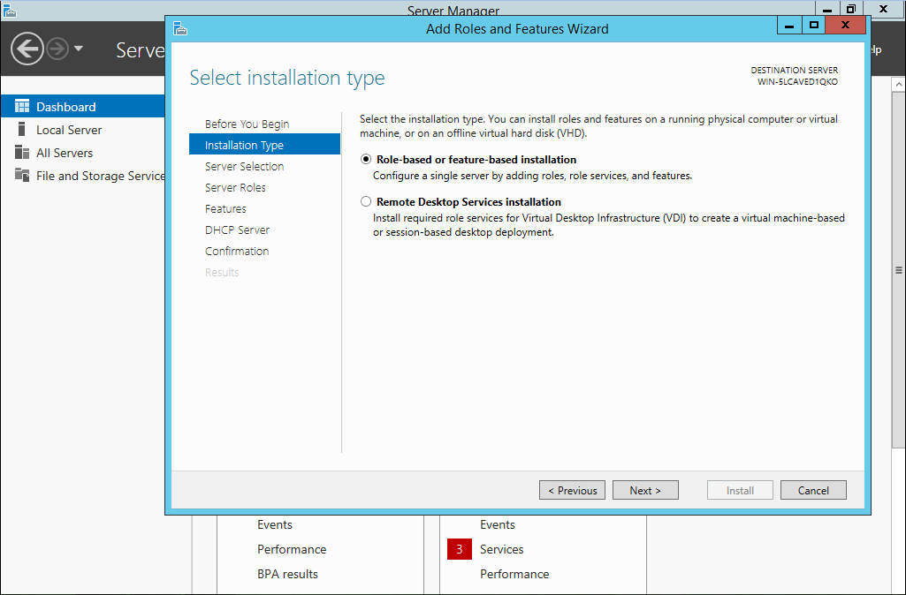
Install and configure DHCP and set the IP pool from 192.168.1.100 to 192.168.1.200
Check the ‘Role based or feature based installation and click next.

Slide 7
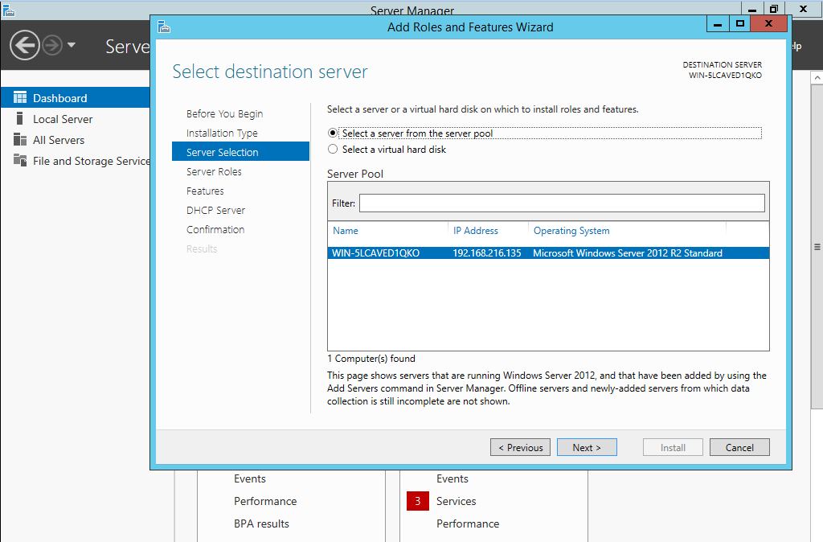
Install and configure DHCP and set the IP pool from 192.168.1.100 to 192.168.1.200
Since you are working on this single server, select the only one on the list. If you are not select the server you wish to install the service on. Click Next.

Slide 8
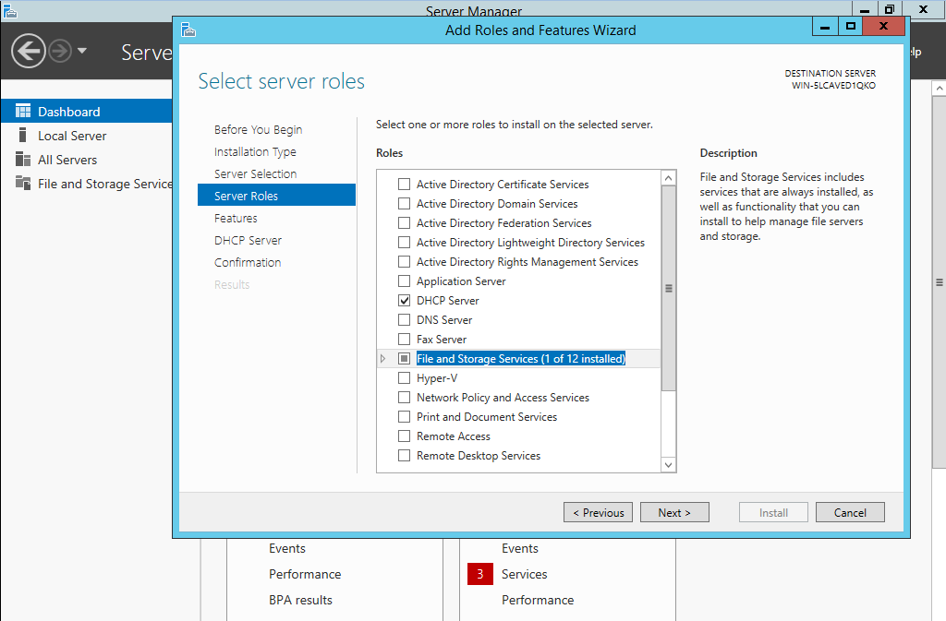
Install and configure DHCP and set the IP pool from 192.168.1.100 to 192.168.1.200
Now since you are setting up a DHCP server, select ‘DHCP Server’. File and Storage Services will automatically be checked. Click Next.

Slide 9
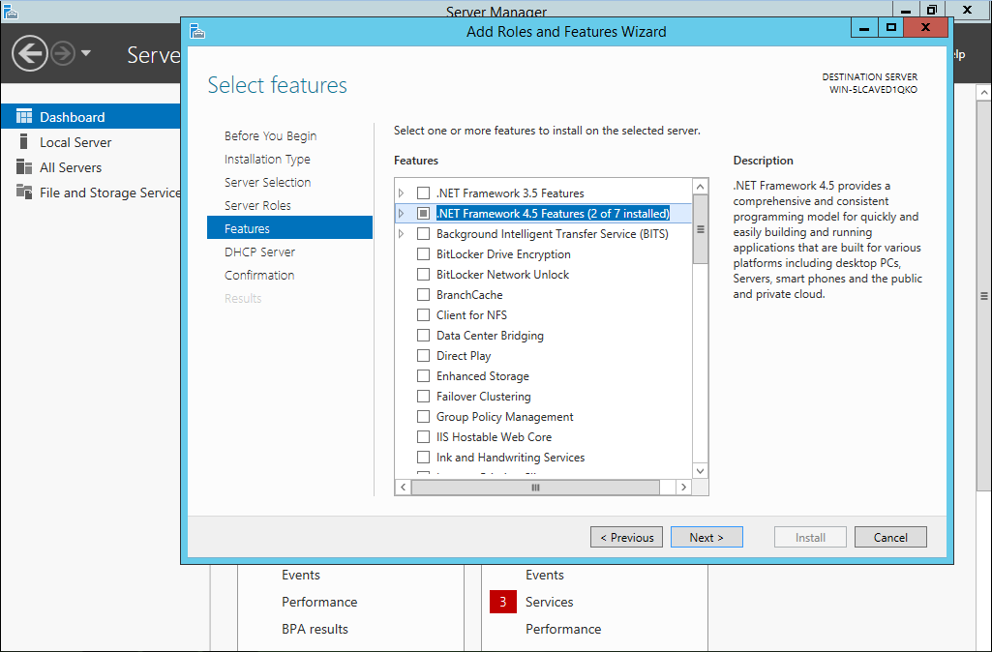
Install and configure DHCP and set the IP pool from 192.168.1.100 to 192.168.1.200
A simple DHCP server won’t require any special features, so leave them all unchecked.

Slide 10
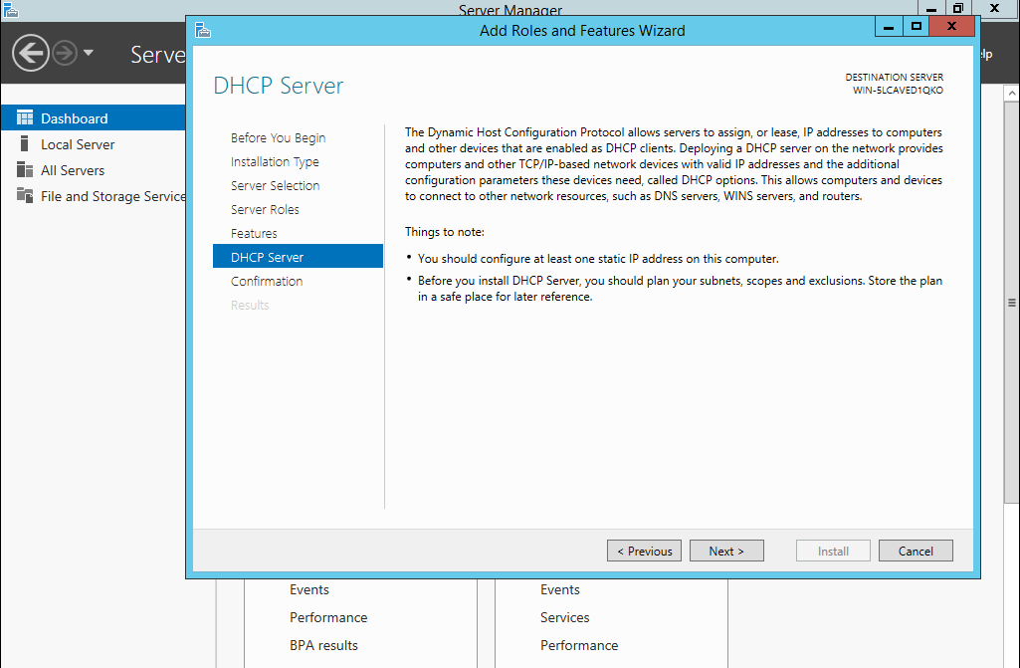
Install and configure DHCP and set the IP pool from 192.168.1.100 to 192.168.1.200
It will give you a few suggestions.

Slide 11
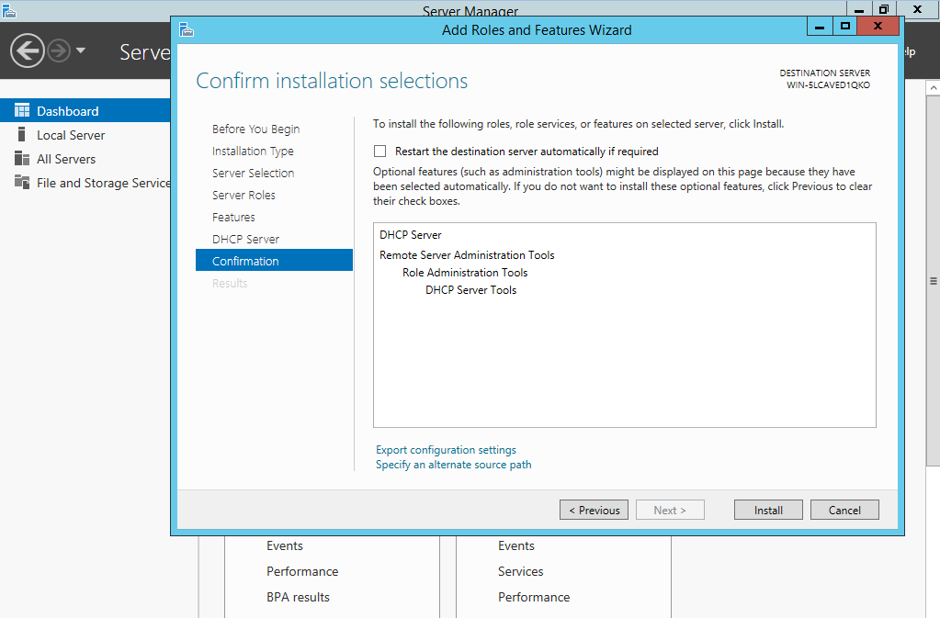
Install and configure DHCP and set the IP pool from 192.168.1.100 to 192.168.1.200
You will see an overview of all the options you chose. If you are satisfied, click install.

Slide 12
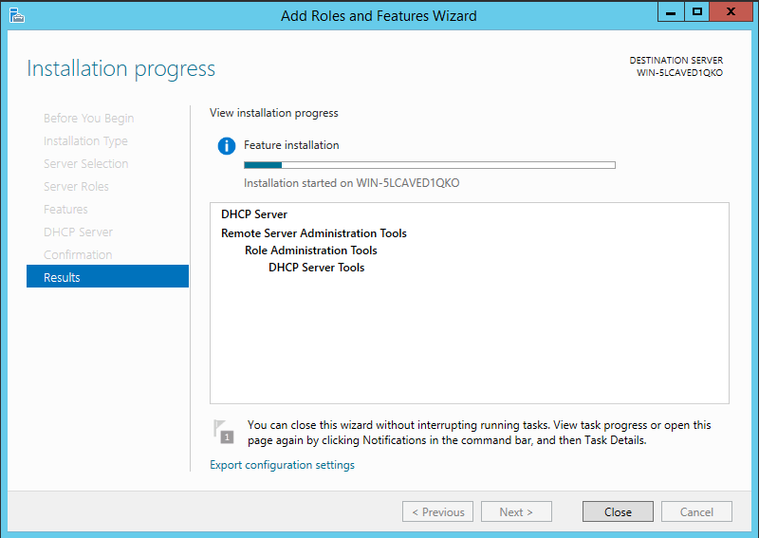
Install and configure DHCP and set the IP pool from 192.168.1.100 to 192.168.1.200
It will take you to an install screen then you will need to restart.

Slide 13
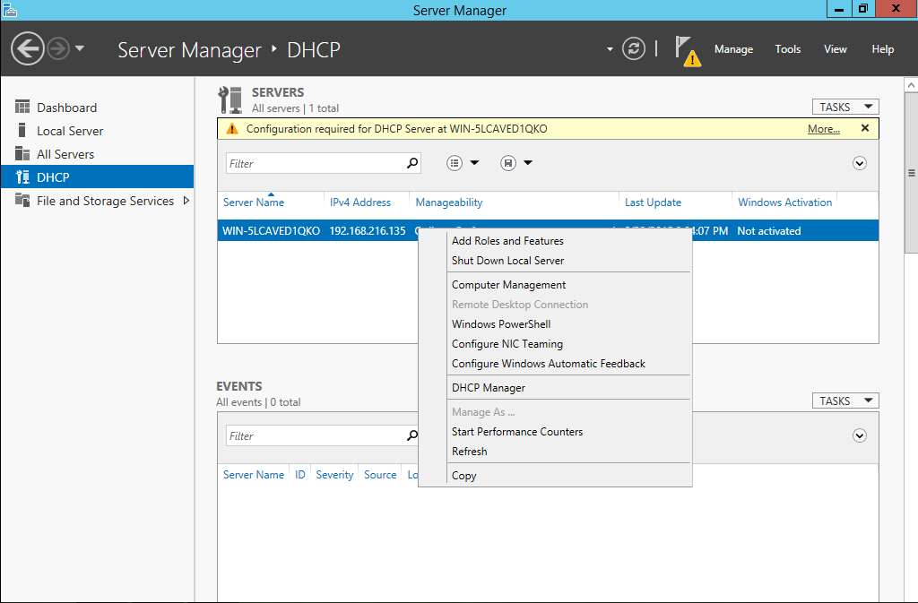
Install and configure DHCP and set the IP pool from 192.168.1.100 to 192.168.1.200
Now that you have the server installed, navigate to it on the left side. Then right click on the server and open DHCP Manager.

Slide 14
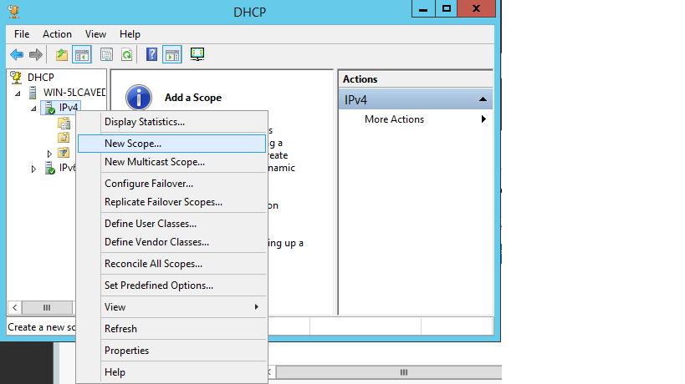
Install and configure DHCP and set the IP pool from 192.168.1.100 to 192.168.1.200
On the left expand your server, then right click IPv4, and click on New Scope

Slide 15
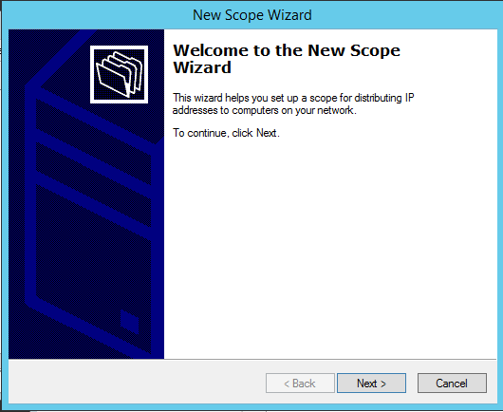
Install and configure DHCP and set the IP pool from 192.168.1.100 to 192.168.1.200
This is the first page of the Wizard. Click next.

Slide 16
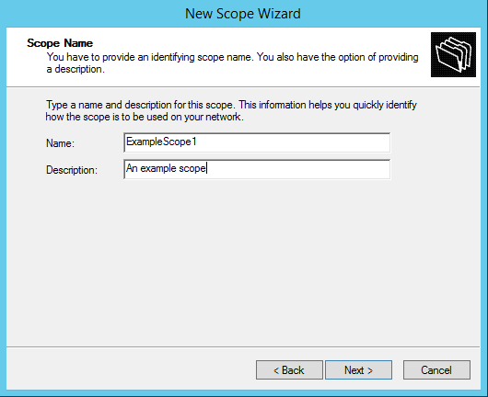
Install and configure DHCP and set the IP pool from 192.168.1.100 to 192.168.1.200
Enter a name to know it by and a quick description, so other admins know what it is.

Slide 17
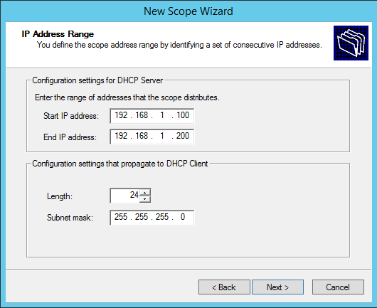
Install and configure DHCP and set the IP pool from 192.168.1.100 to 192.168.1.200
Now enter the Start of the IP range, which for us is 192.168.1.100 and then the End of the IP range, which is 192.168.1.200. The rest will be automatically filled in.

Slide 18
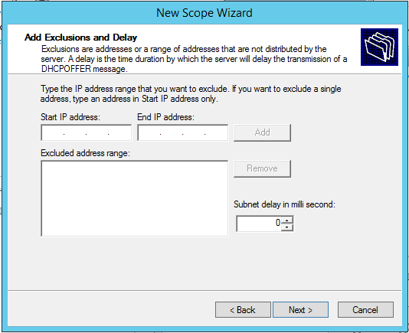
Install and configure DHCP and set the IP pool from 192.168.1.100 to 192.168.1.200
If you were adding any exclusions you would add them here, but we are not, so just click next.
**The subnet delay is used for configuring a split-scope network, which means a network that uses two DHCP servers. General one is considered primary and is given a larger share of IP (80% is standard) The delay is used on the smaller portion to give a chance for the first one to respond so the smaller pool is not exhausted first.**

Slide 19
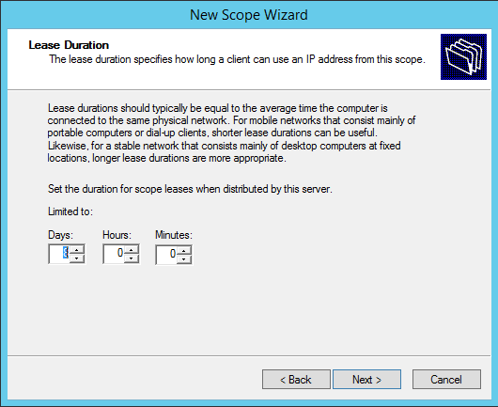
Install and configure DHCP and set the IP pool from 192.168.1.100 to 192.168.1.200
On this screen you set the lease time.

Slide 20
What is Lease Time?
The lease time is the amount of time that an IP is assigned to a node. We use this so a network doesn’t run out of IPs. After the lease time is up, the IP can be reassigned to a different node. If the device is still on the network at half of the lease time it will request to renew its lease.
The lease should be set according to network ‘stability’. Networks that have the same computers on it all the time should have a longer lease time, but a network such as a coffee shop wifi, that has many changing devices needs a short lease so it doesn’t run out of IPs.

Slide 21
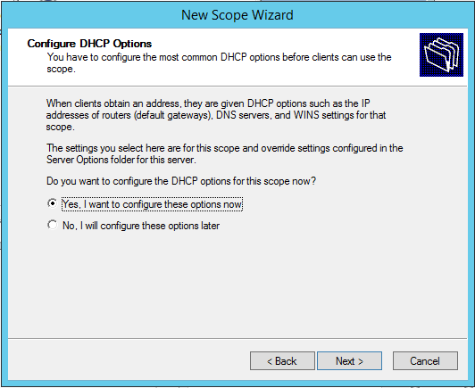
Install and configure DHCP and set the IP pool from 192.168.1.100 to 192.168.1.200
Other than an IP a DHCP server provides nodes with the default gateway and the DNS address. If you want to configure these options now, check yes. We will.

Slide 22
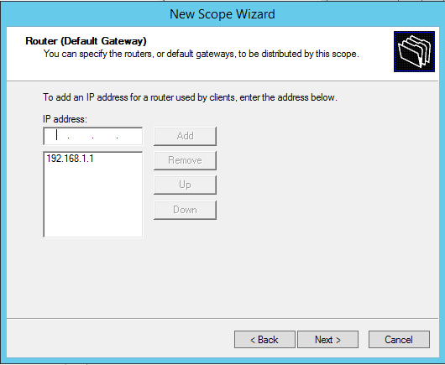
Install and configure DHCP and set the IP pool from 192.168.1.100 to 192.168.1.200
Here we set the default gateway.
Just type it in and click ‘Add’

Slide 23
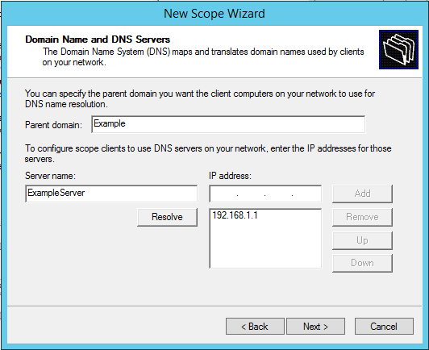
Install and configure DHCP and set the IP pool from 192.168.1.100 to 192.168.1.200
Now we must give a domain name to the server. This is what will go into the DNS server to be resolved for this server’s IP.
The second thing you must enter is the DNS server. Enter its name and IP.

Slide 24
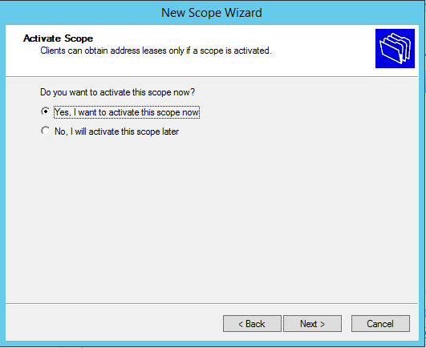
Install and configure DHCP and set the IP pool from 192.168.1.100 to 192.168.1.200
If you want these setting to take effect now, check yes. If you want to have them take effect later, check no. We want them now so we will check yes.

Slide 25
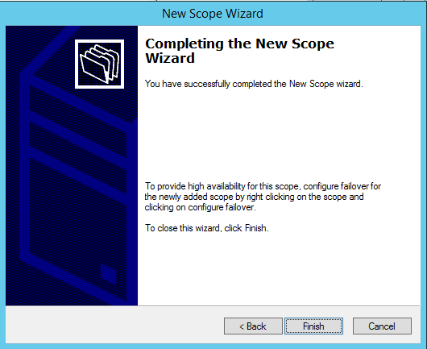
Install and configure DHCP and set the IP pool from 192.168.1.100 to 192.168.1.200
You’re done! Click ‘Finish’ to add the scope.

Slide 26
Add a filter to the pool so that MAC address AA:AA:AA:AA:AA:AA is blocked and no IP address is given to that MAC address
To block a MAC address open up the DHCP manager. Go to the DHCP service, right click the server, and click DHCP Manager.

Slide 27
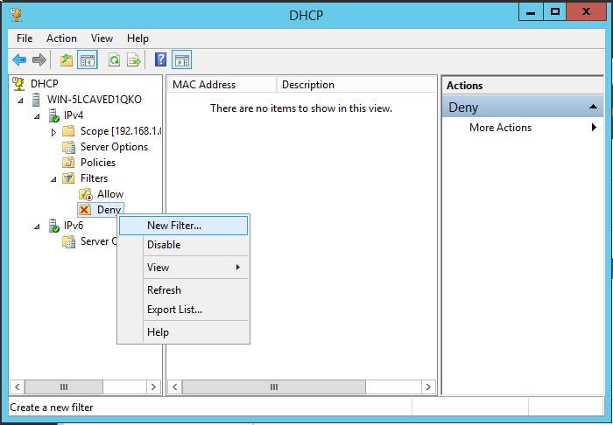
Add a filter to the pool so that MAC address AA:AA:AA:AA:AA:AA is blocked and no IP address is given to that MAC address
Now expand your server, IPv4, and Filters. Under Filters, right click deny and then click ‘New Filter...’

Slide 28
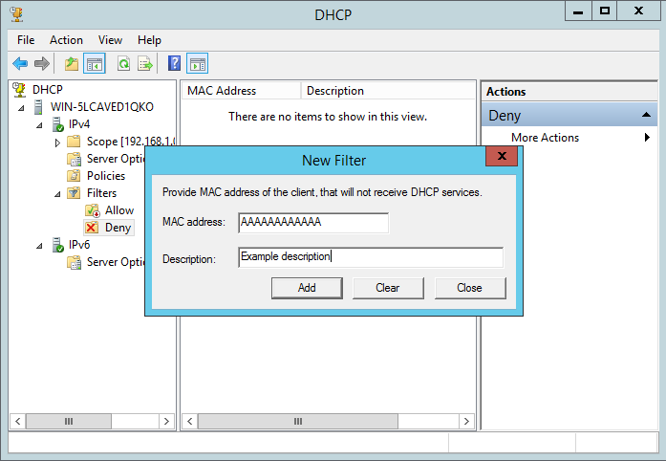
Add a filter to the pool so that MAC address AA:AA:AA:AA:AA:AA is blocked and no IP address is given to that MAC address
In the new filter, enter the MAC address, we will use AA:AA:AA:AA:AA:AA
as an example. Then enter a description so other admins know why its blocked.

Slide 29
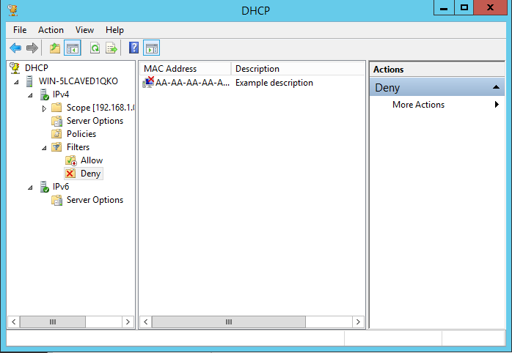
Add a filter to the pool so that MAC address AA:AA:AA:AA:AA:AA is blocked and no IP address is given to that MAC address
That’s it, you’re done.
Any device with this MAC address will not receive an IP.

Slide 30
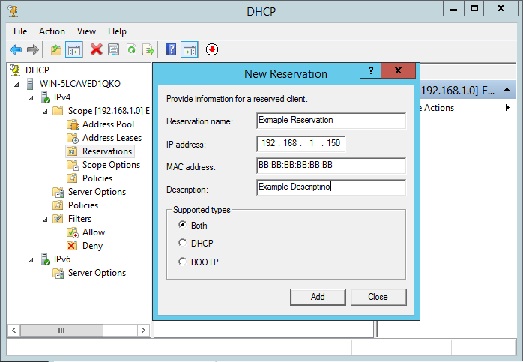
Reserve IP address 192.168.1.150 to MAC address BB:BB:BB:BB:BB:BB
**BOOTP is just an older host protocol, that was general replaced by DHCP**
To reserve an IP stay in the DHCP manager, under scope, right click ‘Reservations and click ‘New Reservation’. It will bring up this window. Enter a name, IP and MAC addresses, and description. Leave the supported type on both. Then click add.

Slide 31
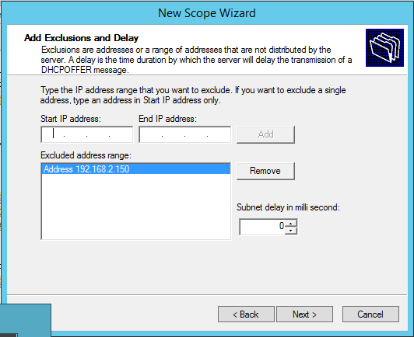
Make another pool having IP pool from 192.168.2.100 to 192.168.2.200 and exclude IP address 192.168.2.150 from the range
To make this scope follow the same steps as before (inputting the updated information). The change will be on this screen. If you are excluding only one IP type it in the Start IP address box and click add. If you are excluding a range, type both ends.

Slide 32
Active Directory

Slide 33
Install and configure active directory. (use the same domain name used while configuring DHCP)
To install active directory add a new server role from the Server Manager.

Slide 34
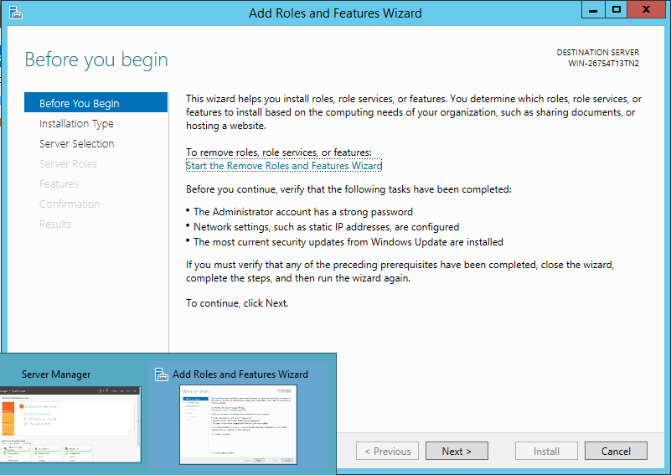
Install and configure active directory. (use the same domain name used while configuring DHCP)
Start with the ‘Add Roles and Features Wizard’. It gives you a few requirements.
Such as the administrator has a strong password and a static IP.

Slide 35
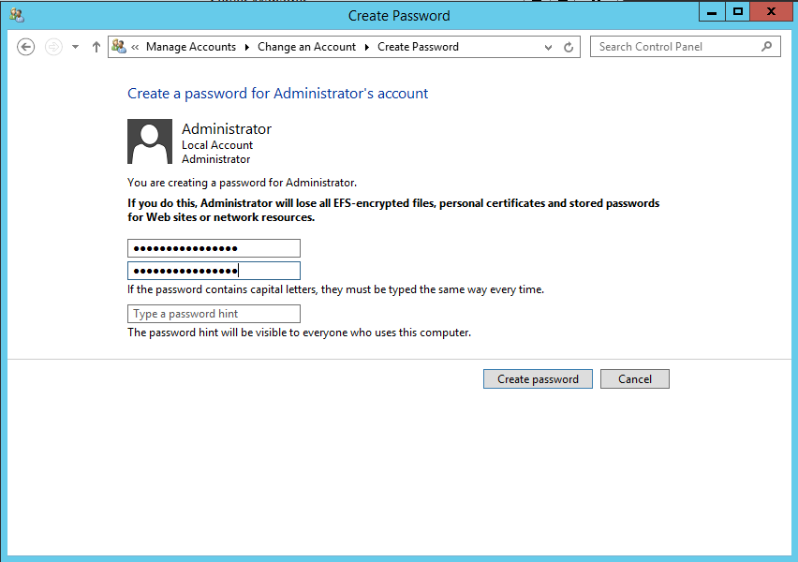
Install and configure active directory. (use the same domain name used while configuring DHCP)
First we will give the Administrator a strong password, because this account will automatically become admin over the domain.

Slide 36
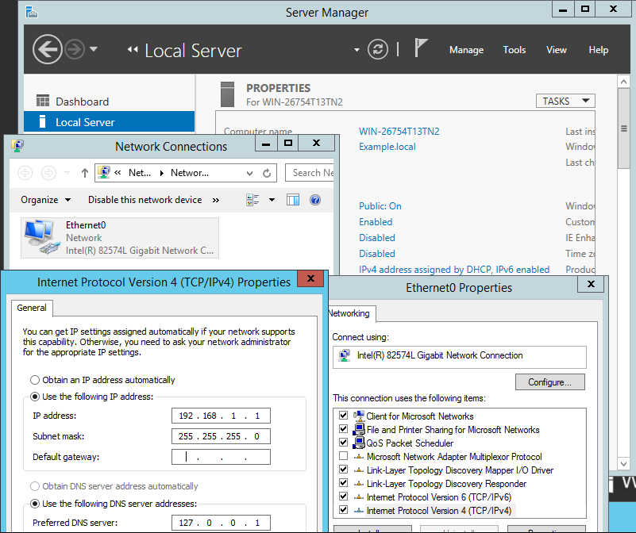
Install and configure active directory. (use the same domain name used while configuring DHCP)
Now we will assign a static IP. We want a static IP because it would crash the network if it changed and it would be unreliable with DHCP
Go to ‘Local Server’
Click on ‘IPv4 address...’
Right click on Ethernet0 and click on ‘Properties’
Double click Internet Protocol Version 4(TCP/IPv4)
Check ‘Use an IP address auto...’ and fill in IP

Slide 37
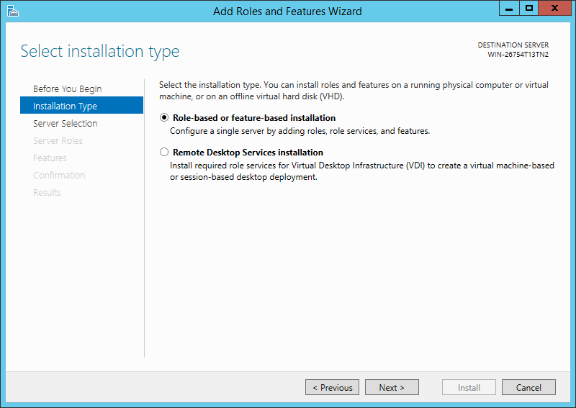
Install and configure active directory. (use the same domain name used while configuring DHCP)
Now we can continue with the Role installation. Select ‘Role-based or feature-based installation’. Click Next.

Slide 38
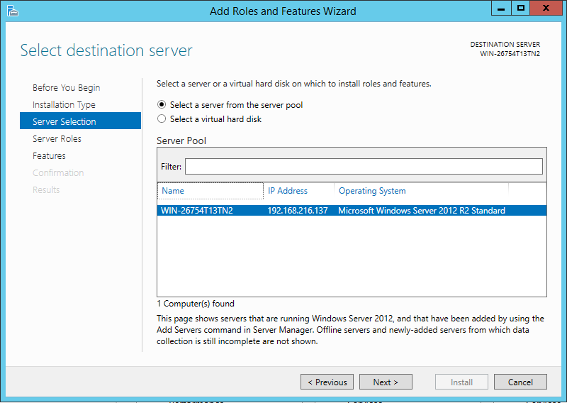
Install and configure active directory. (use the same domain name used while configuring DHCP)
Here you select a server. Since we only have one we will just click next.

Slide 39
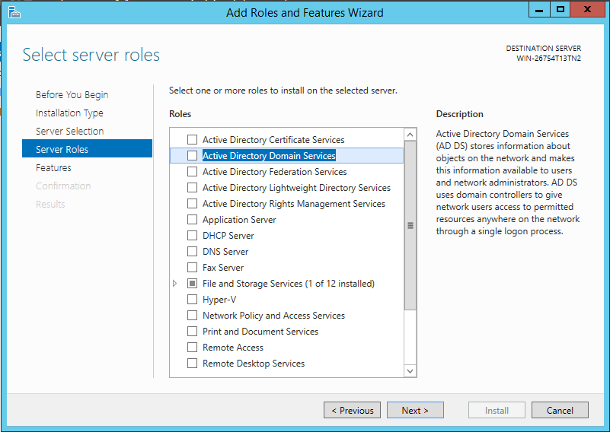
Install and configure active directory. (use the same domain name used while configuring DHCP)
This menu lets you select server roles. We are installing a Active Directory Domain Server, so we will choose so.

Slide 40
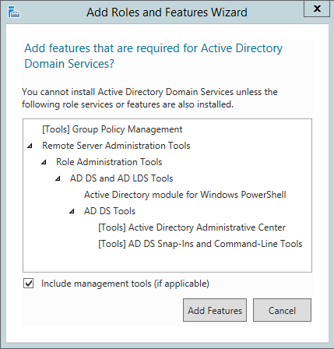
Install and configure active directory. (use the same domain name used while configuring DHCP)
It will bring up another menu informing you of all the features that are required. They will automatically be installed. Just click ‘Add Features’

Slide 41
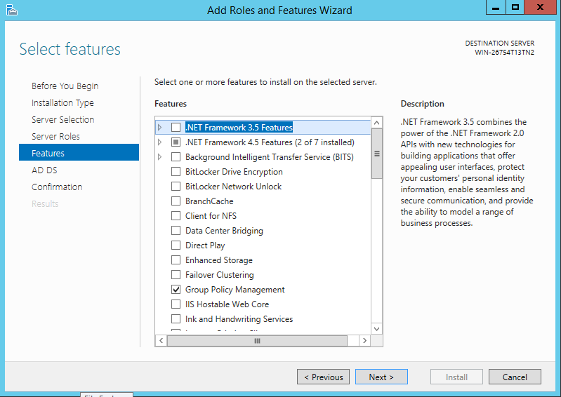
Install and configure active directory. (use the same domain name used while configuring DHCP)
This is the features window. Since it already selected all the ones we need we can click next.

Slide 42
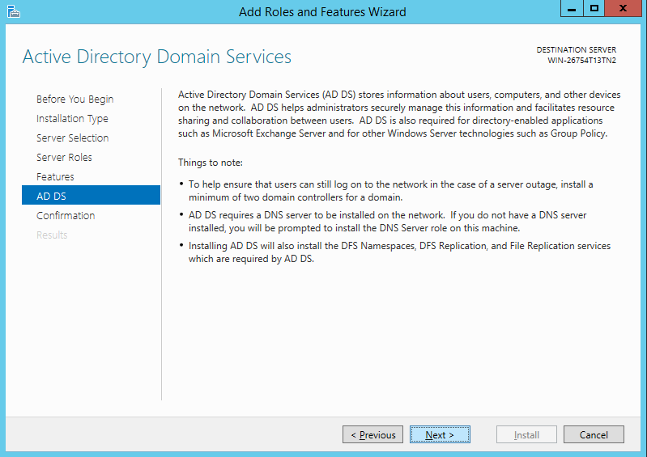
Install and configure active directory. (use the same domain name used while configuring DHCP)
Here you get a little more info before you install. Click next after reading it.

Slide 43
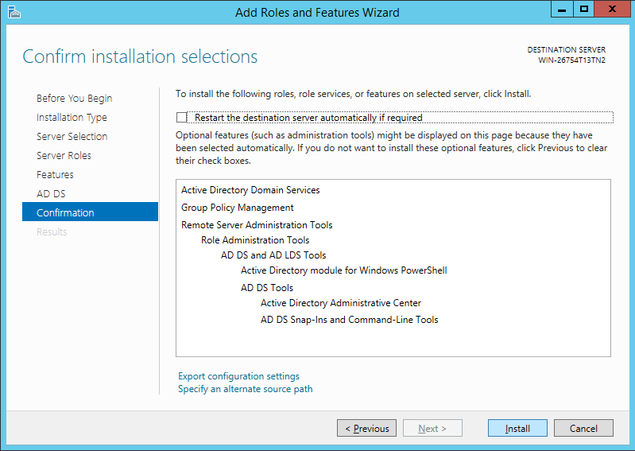
Install and configure active directory. (use the same domain name used while configuring DHCP)
Finally you look over everything. Check the ‘Restart the destination...’ box. This will automatically restart the server to apply the changes.

Slide 44
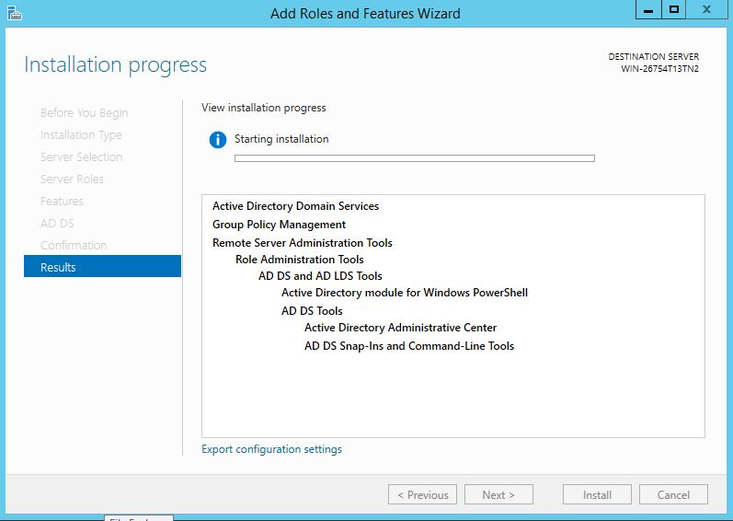
Install and configure active directory. (use the same domain name used while configuring DHCP)
It will bring you to the install screen. Let it finish. It will restart the machine.

Slide 45
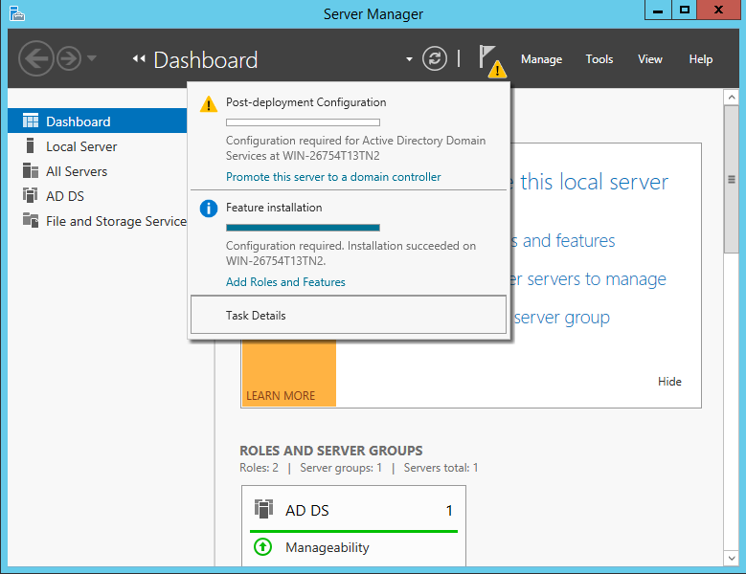
Install and configure active directory. (use the same domain name used while configuring DHCP)
After it restarts open the Server Manager backup. There will be a warning icon prompting you to promote the server to a domain controller. This is because there are no other detected controllers. Click the link.

Slide 46
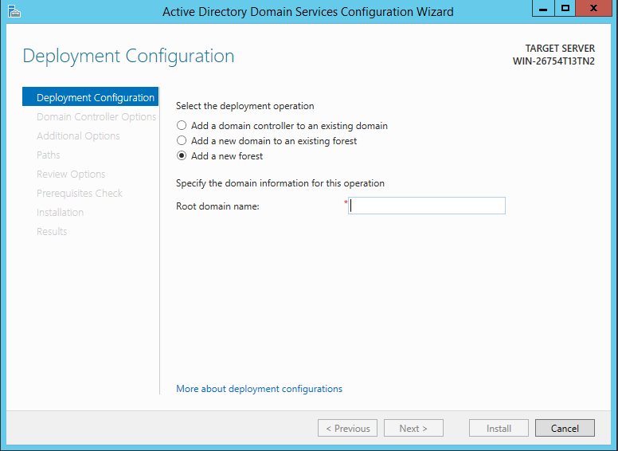
Install and configure active directory. (use the same domain name used while configuring DHCP)
The link will bring you to this menu. Since this is a brand new Directory, we must create a new forest. Check ‘Add a new Forest and specify a new root name. It should carry the parent domain. We will use “Example.local” because we used “Example” in the DNS server.

Slide 47
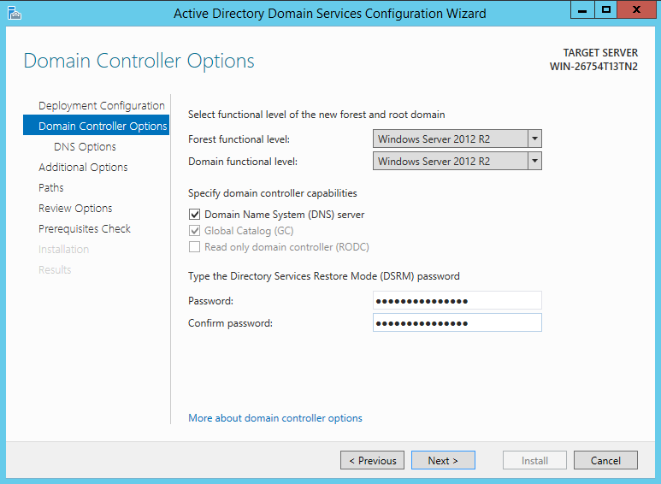
Install and configure active directory. (use the same domain name used while configuring DHCP)
Next we go to the ‘Domain Controller Options’. We will keep the Forest and Domain function level set at Window Server 2012 R2, this is the only Domain Controller and it meets the requirements. The boxes are grayed out because they are required. The last thing is Restore password. You need this incase you need to restore the server.

Slide 48
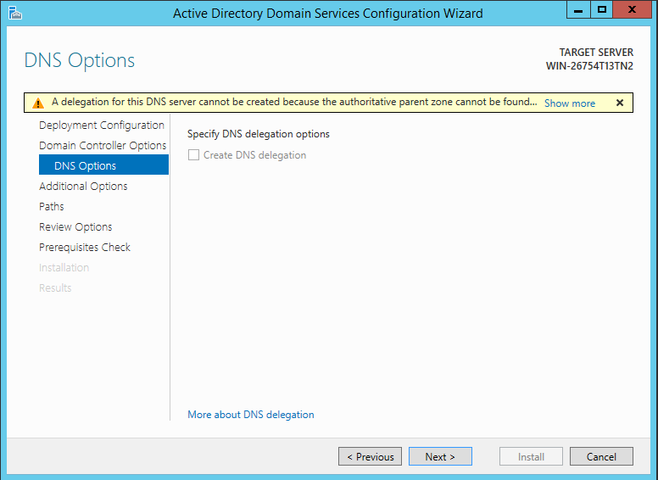
Install and configure active directory. (use the same domain name used while configuring DHCP)
The next screen is the ‘DNS Options’ It will give you a warning. Since there is no DNS service on this server ignore it. Click next.

Slide 49
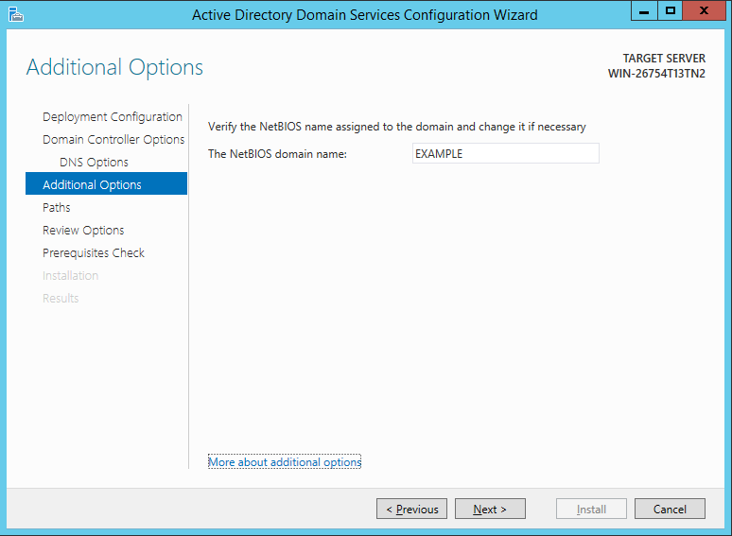
Install and configure active directory. (use the same domain name used while configuring DHCP)
In ‘Additional Options’ it will auto generate the NetBios domain name. Leave it.

Slide 50
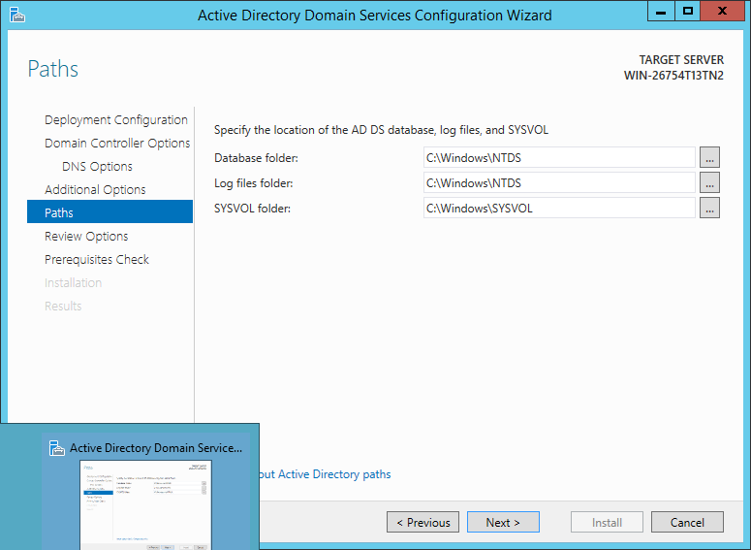
Install and configure active directory. (use the same domain name used while configuring DHCP)
You can specify the paths of the Database, Log, and SYSVOL folders, but we will leave them at the default.

Slide 51
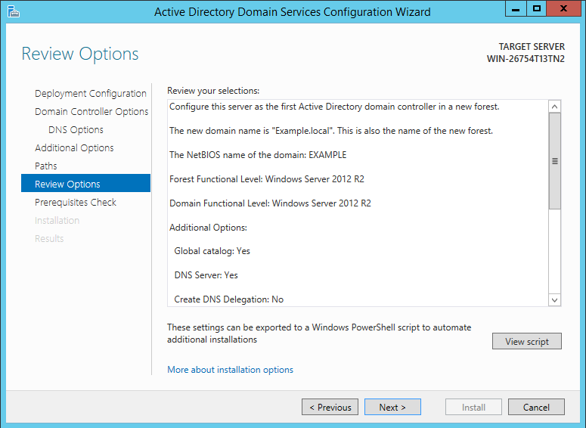
Install and configure active directory. (use the same domain name used while configuring DHCP)
This screen is to review all your setting.

Slide 52
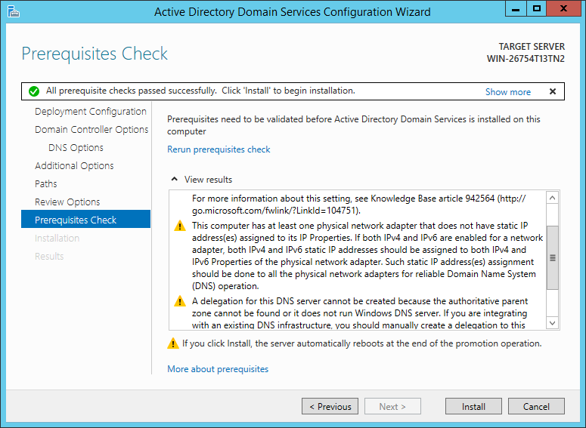
Install and configure active directory. (use the same domain name used while configuring DHCP)
This is the final screen, it will run some system checks to make sure everything is ready. If everything is configured correctly you can click install. It will install, and your Active Directory is ready.

Slide 53
DNS
Domain Name System

Slide 54
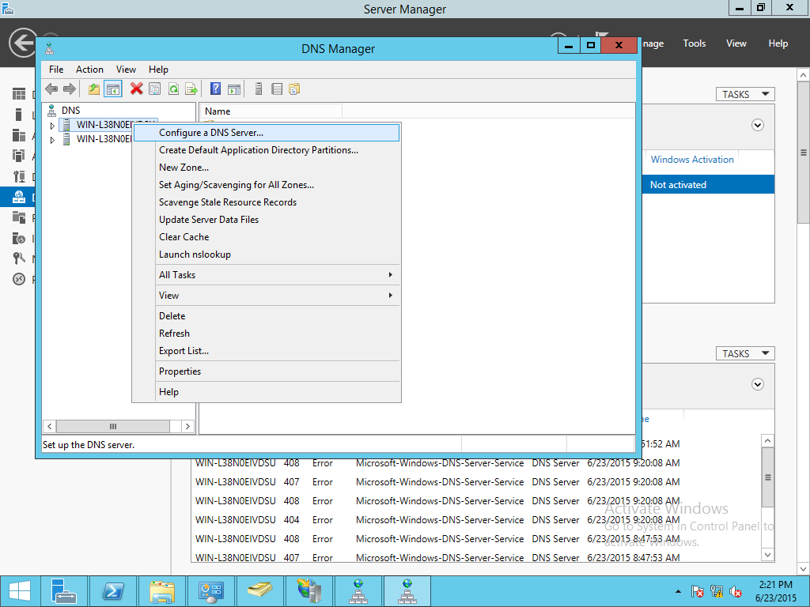
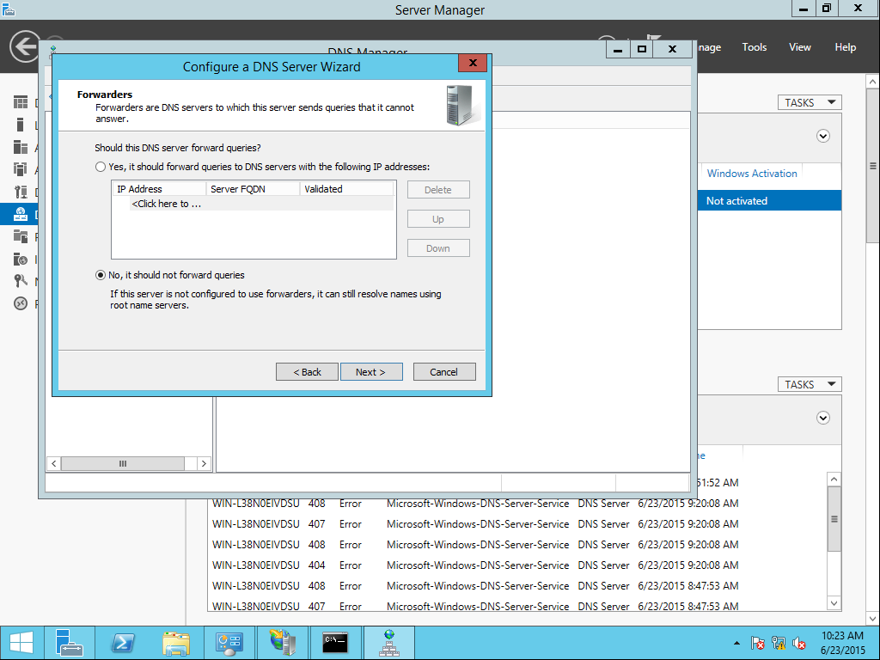
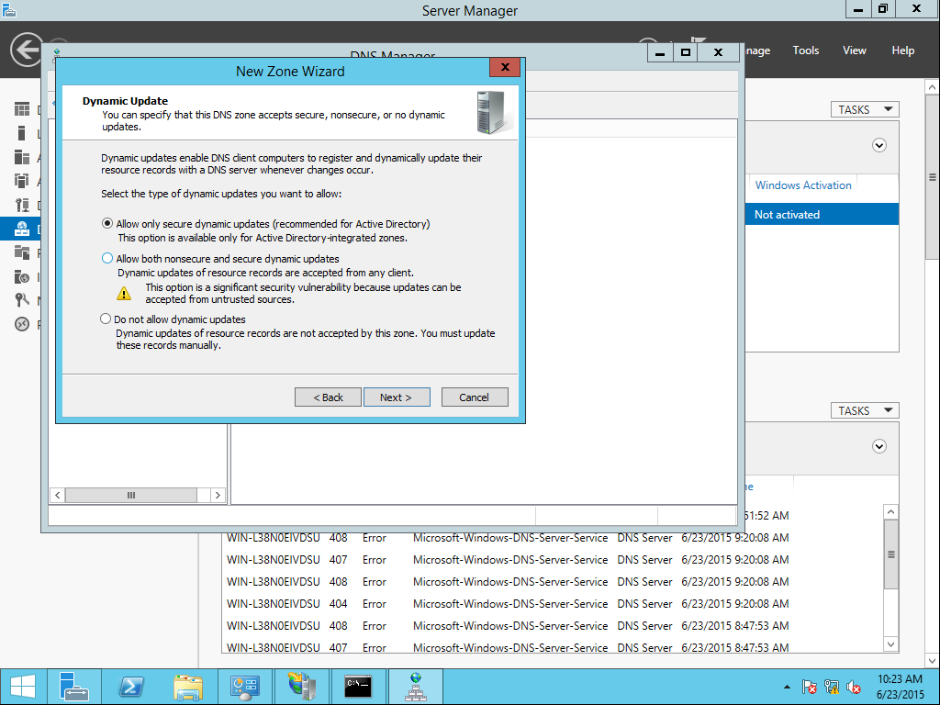
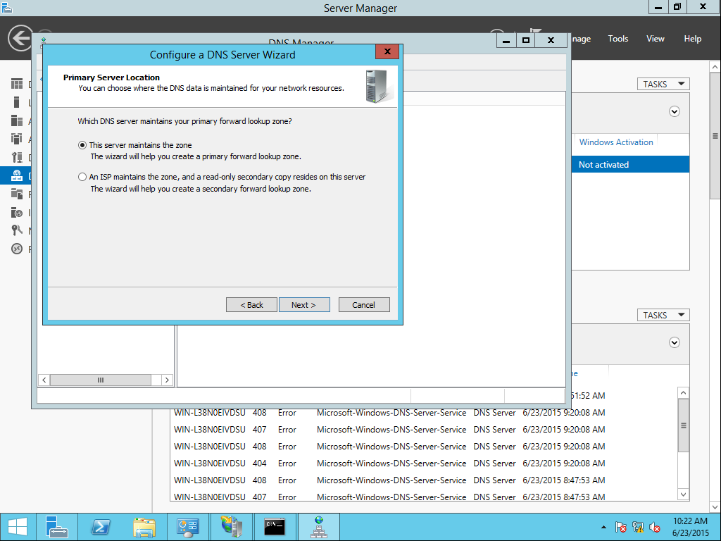
Configure a simple forward lookup DNS service, make it so that "this server maintains the zone", give any zone name (same as the domain name used while configuring DHCP and active directory), make it so that it allows only secure dynamic update and turn off forward queries.
In the DNS Manager right-click your server and select Configure a DNS Server
Make sure The server maintains the zone is selected
Click next and then make sure No, it should not forward queries is selected
In the DNS Manager right-click your server and select New Zone
Make sure Allow only secure dynamic updates is selected

Slide 55


Add a mx record (mail.<your domain name>.com)
In the DNS Manager right-click your zone and select New Mail Exchanger
Input the required information

Slide 56


Add 2 cname records (test.<your domain name>.com and test2.<your domain name>.com)
In the DNS Manager right-click your zone and select New Alias
Input the required information

Slide 57


Add one A record (www.<your domain name>.com)
In the DNS Manager right-click your zone and select New Host
Input the required information

Slide 58

Ping each record and see if you get a reply
Open a command prompt and type “ping mail.Team5.com” to ping the mail record. As you can see we get a reply so it worked.

Slide 59


Allow zone transfer only from the server in nameserver
Right-click your zone and select properties
Go to the Zone Transfers tab
Check Allow Zone Transfers and then select the second option

Slide 60


Make sure "disable recursion" is configured
Right-click your server and go to properties
Go to the Advanced tab and make sure Disable recursion is checked

Slide 61

Make sure "secure dns cache against name pollution" is configured
In the same window scroll down to Secure cache against pollution and check it

Slide 62


Make dns active directory integrated
In the Zone Properties select the General tab and then choose Change zone type
Make sure the last box is checked to enable Active Directory

Slide 63

Debug log everything
In the Server Properties select the Debug Logging tab and make sure everything is checked

Slide 64

Configure so that CEO has full control over DNS
Also in the Server Properties go to the Security tab and select CEO then make sure Full control is checked under Allow

Slide 65
IIS
Internet Information Services

Slide 66


Install and configure IIS
In Server Manager right-click on the server in IIS and select the IIS Manager
In the tree navigate to Sites

Slide 67


Make a web site for your domain (www.<your domain name>.com)
Right-click on Sites and select Add Website
Input your Site name, physical path, and Host name

Slide 68

Make 2 more websites for the 2 cname and put in 2 folders test1 and test2 (test.<your domain name>.com and test2.<your domain name>.com)
Add another website and name it Test1
Set the path to your test1 folder
Set the hostname to test1.<domain name>.com
Repeat for test2

Slide 69

Create new folder in test1 and test2 and add some documents in each of the new folders that you created.
Navigate to the directory of your test1 and test2 folders that you put your ftp site in and right click then choose New>Folder
Add some documents

Slide 70


Make sure it asks for the username and password when accessing the website for cname.
In the IIS Manager navigate to your site and select Authentication
Disable Anonymous Authentication and Enable Basic Authentication

Slide 71
SMTP
Simple Mail Transfer Protocol

Slide 72


Install and configure SMTP server
Launch the Internet Information Services (IIS) 6.0 Manager.
Right-click on SMTP Virtual Server #1 and select Properties.
Select the General tab and change the IP Address to the server’s IP address.

Slide 73

Install and configure SMTP server
In the Delivery tab of the Connection window, set an external domain.

Slide 74

Install and configure SMTP server
Launch the Windows Firewall with Advanced Security console.
Right-click on 'Inbound Rule' and select 'New Rule' to begin the wizard.

Slide 75



Install and configure SMTP server
Select 'Port' and click Next.
Set the local port to 25 and click Next.
Choose 'Allow the connection' and click Next.

Slide 76



Install and configure SMTP server
Uncheck 'Public' to prevent external access to the server. Click Next.
Give the rule a name, and click Finish.
You should now see a new rule enabled in the firewall management console.

Slide 77


Configure integrated windows authentication to access the mail server.
Open SMTP properties and click Authentication
Make sure Integrated Windows Authentication is checked

Slide 78


Configure outbound security to integrated windows authentication
In Properties select the Delivery tab and then click Outbound Security
Select the Integrated Windows Authentication and put in your account name and password

Slide 79


Allow connection control to IP addresses 192.168.1.10, 192.168.1.11, 192.168.1.12 and the server itself
Again in Properties, select the Access tab and then click Connection
Select Only the list below then click add and add the IP addresses you want to be able to control the SMTP server

Slide 80

Allow only the server to relay through the mail server.
To allow only the server you just remove the other IPs until the server is the only one left

Slide 81

Allow max connection= 100
Under the general tab, check the ‘Limit number of connections to:’ and type 100 in the box. Click ‘Apply’

Slide 82

Turn on logging
Under the ‘General’ tab Check the ‘Enable logging’ box.

Slide 83

Grant operator permissions to CEO
Open the ‘Security’ tab. Click ‘Add’ and select the CEO.

Slide 84

Perform reverse dns lookup on incoming mails
Under the ‘Delivery’ tab, click on ‘Advanced’. Check the ‘Perform reverse DNS...’ box.

Slide 85
Remote Desktop

Slide 86

Install and configure Remote desktop services with the following properties:
Before we can start configuring Remote Desktop, we have to install the RD Role to the server.

Slide 87

Permissions for later
While setting up the server you will be prompted to decide who can access it. Add user 1 and 2 for a later step.

Slide 88


Max connections = 10
In the Remote Desktop Session Configuration go under connections and right-click the name of your connection, from here click properties.
In the Network Adapter tab click maximum connections and set to 10.

Slide 89

Max monitors per sessions = 10
In the same Properties window described in slide 94, choose the client settings tab.
Once here, find the monitor settings option and set the maximum number of monitors per session to 10.

Slide 90

Always ask for password
To configure to always prompt for a password, from the same properties box described in slide 94, choose the Log on Settings Tab.
From here check the box that says “Always prompt for password.”

Slide 91

Use client provided authentication
This box was checked automatically for me. However to make sure use the same properties window described in slide 94 and navigate to the Log on Settings tab. From here use the highlighted bubble to select whether client-provided authentication is used.

Slide 92

End connection after 15 idle minutes
Use the same properties window as described in slide 94. Click on the sessions tab at the top.
First you’ll have to override the user settings, check the box for this, highlighted in yellow.
Next, in the dropdown menu for Idle Session Limit, highlighted red, select 15 minutes.

Slide 93
Disable audio and video recording
Back in the Client Settings tab of the properties window described in slide 94, we can disable Audio Recording, as well as video and audio playback. The checkboxes for these options are highlighted.
Video recording seems to require third party software.

Slide 94


Only users 1, 2 and CEO can access the server. Configure so that users 1 and 2 can only logon and logoff and CEO can do everything.
In Slide 78 I told you to add some permissions for later.
This is where these come in, Users 1 and 2 have been added to a group “Remote Desktop Users.” Because of this they have User level privileges. You can modify privileges in the boxes highlighted in red.

Slide 95

Use SSL TLSv1.0 for server authentication and keep encryption high
In the same properties window described in slide __ Go under the general tab and down to the security section.
Use the highlighted drop down menus to change the Security layer to SSL (TLS 1.0) and the Encryption level to High.

Slide 96


Once configured RDP to the server from accounts user1 and CEO
Above is the prompt to sign in to RPD.
On the right is the login screen once connected.

Slide 97
FTP
File Transfer Protocol

Slide 98
Install an ftp server
Use the same method to add roles as before

Slide 99

Create a folder called FTP in the C:\user\public directory
Navigate to the directory and right click then choose New>Folder.

Slide 100




Create 2 groups FTP_admin and FTP_users and Add CEO to FTP_admin group and add users 1 through 5 to FTP_users group.
In the Active Directory Users and Computers right click under Users and select Group>New and name your new group
Then right-click on the user you want to add and select All Tasks>Add to a group. Input the name of the group you want to add to and press OK

Slide 101



Configure an FTP site with name (ftp.<your domainname>.com) and make sure SSL is used
In the IIS Manager select Sites then on the right sidebar click Add New FTP Site
Put in the IP of the server and make sure Require SSL is selected
Put in the name and the path to the folder we created earlier

Slide 102





Allow FTP_admin read and write access and allow only read access to the FTP_users group.
Finish the wizard by giving the FTP_admin group read and write permissions
Then right-click on the site and select Edit Permissions
Select Edit then Add and choose the FTP_users group and give them Read but not write access

Slide 103
Resources
https://technet.microsoft.com
http://blog.hyperfive.com/2013/07/how-to-setup-internal-smtp-service-for.html

